Slide 1
Starting System
Starting System Overview:
Uses a powerful electric motor to drive the engine at about 200 RPM (fast enough to allow the fuel and ignition systems to operate).
Drives the engine through a pinion gear engaged with a ring gear on the flywheel.
Disengages as soon as the engine starts.

Slide 2
Starting System Components
These components make up a starting system
Starter motor
Magnetic switch
Over−running clutch
Ignition switch contacts
Park/neutral position (A/T) or clutch start (M/T) switch
Clutch start cancel switch (on some models)
Starter relay

Slide 3
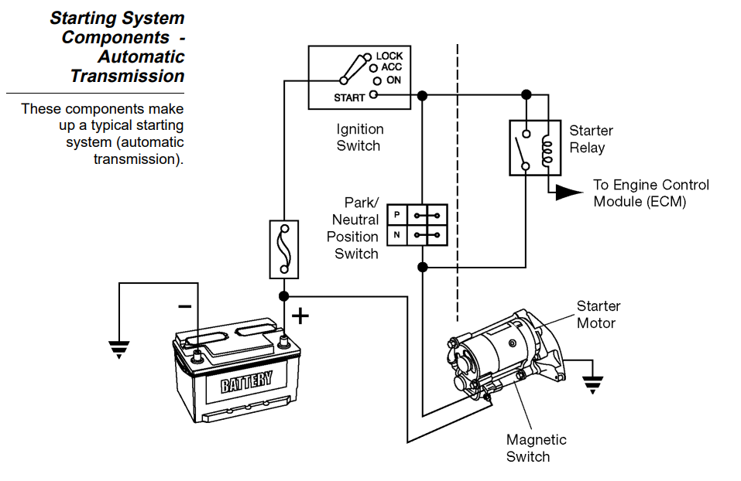
Starting System Components – Automatic Transmission

Slide 4
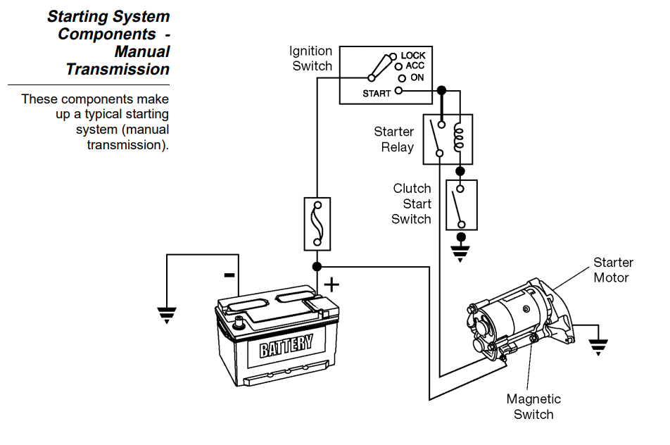
Starting System Components - Manual Transmission

Slide 5
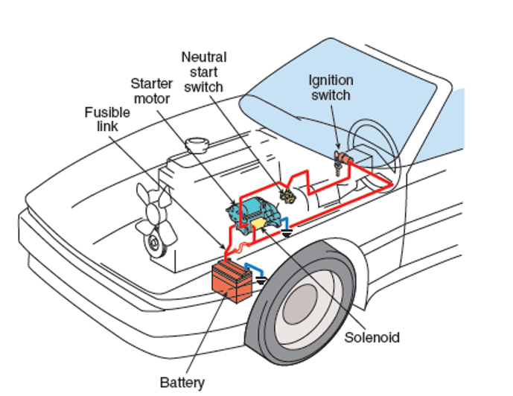
Starting System Components…..

Slide 6
over−running clutch
The clutch prevents damage to the starter when the engine starts.
Clutch Operation:
During engine start, the starter pinion gear drives the engine’s flywheel ring gear.
Once the engine fires, the ring gear almost instantly begins to turn faster than the starter pinion gear. Over−speeding would damage the starter motor if it were not immediately disengaged from the pinion gear.
The clutch uses its wedged rollers and springs to disengage the pinion shaft from the clutch housing (which turns with the motor armature). This happens any time the pinion shaft tries to turn faster than the clutch housing.

Slide 7
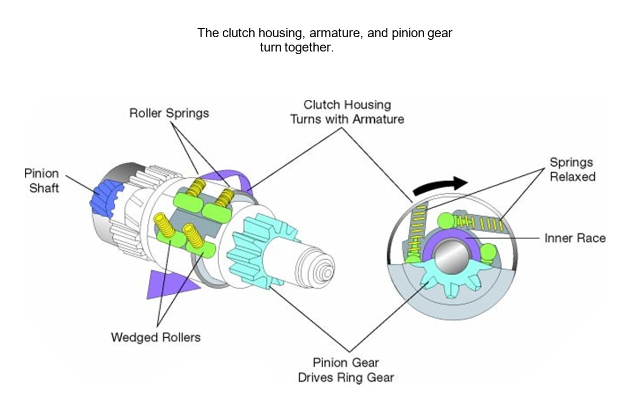
over−running clutch…..

Slide 8
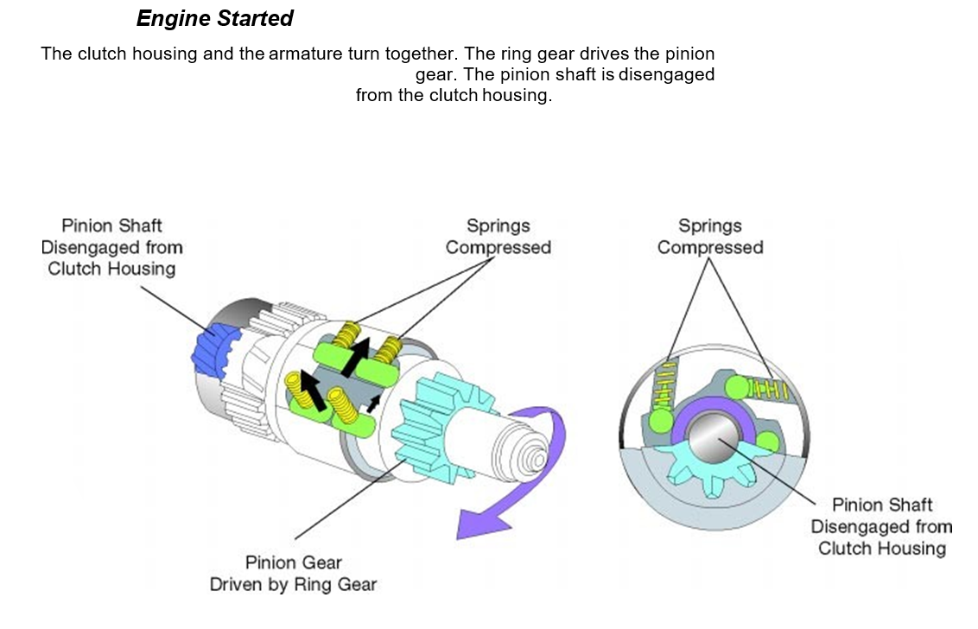
over−running clutch…..

Slide 9
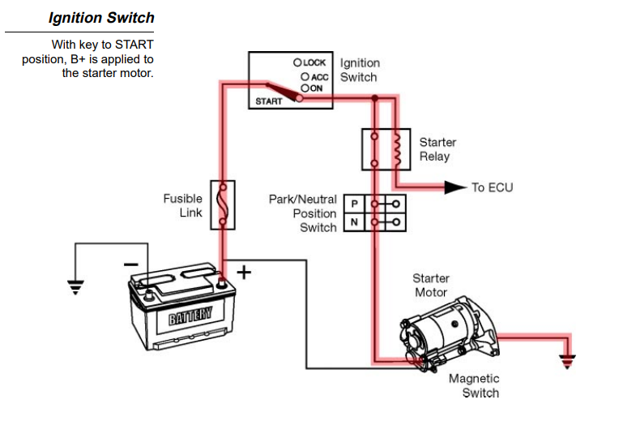
Ignition Switch
The ignition switch incorporates contacts to provide B+ to the starter. The relay energizes the starter magnetic switch when the driver turns the ignition key to the START position.

Slide 10
Diagnosis and Testing
The starting system requires little maintenance. The battery should be fully charged and connections kept clean and tight.
Diagnosis of starting system problems is usually straightforward. Problems may be electrical or mechanical.
The Starting System Troubleshooting chart lists the most common starting system problems, the possible causes, and recommended actions to resolve the problem.
Begin with a thorough visual inspection. If this fails to turn up the possible cause, several tests are available to help you find the problem:
Starter motor current draw test
Voltage drop tests
Operational and continuity tests
Starter motor bench tests

Slide 11
Voltage Drop Tests- Starter Motor Circuit
Voltage drop tests can find excessive resistance in the starting system. High resistance in the starter motor circuit can;
Reduce starter motor current.
Cause slow cranking.
Preparation − Prepare the tester and the vehicle with these steps:
Disable the fuel or ignition system so engine will not start while cranking. For most vehicles, you can pull the Electronic Fuel Injection (EFI) fuse or relay to prevent engine start.
Set the VAT−40 volt selector to EXT 3 (volts). If you’re using a DMM, select a low voltage scale.
Normal voltage drops in the starting system are in the range of 0.2 volts to 0.5 volts.

Slide 12
Battery Positive Cable
This test measures the voltage drop across the positive battery post to the cable and the connections at the battery and the starter.
Do not crank the engine longer than 10 seconds at a time.
Crank the engine and note the voltage reading: 0.5 volts or less is acceptable resistance, More than 0.5 volts is excessive resistance
If you find excessive resistance, perform these steps:
Isolate the cause
Repair the fault
Re−test the voltage drop
Excessive resistance could be caused by any of these:
Damaged battery cable
Poor connection at battery or starter terminal
Defective magnetic switch

Slide 13
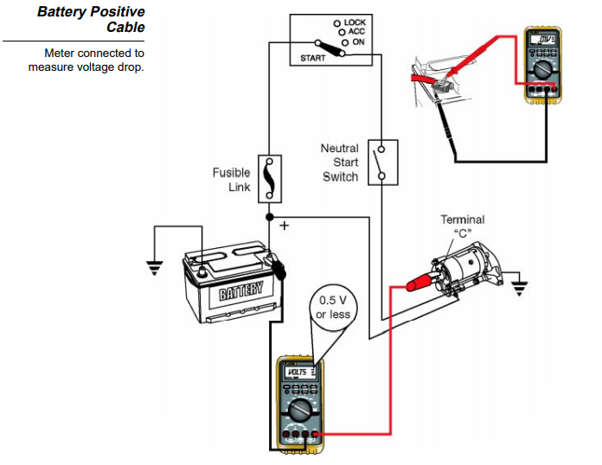
Battery Positive Cable…..

Slide 14
Battery Negative Cable
This test measures the voltage drop across the negative battery cable, the connections at the battery and the starter, and the connection to ground through the starter motor case:
Connect the tester or meter leads:
Red lead to the starter motor housing
Black lead to negative terminal of the battery
Note; do not crank the engine longer than 10 seconds at a time.
2) Crank the engine and note the voltage reading:
0.2 volts or less is acceptable resistance
More than 0.2 volts is excessive resistance
If you find excessive resistance, perform these steps:
Isolate the cause
Repair the fault
Re−test the voltage drop
Excessive resistance could be caused by any of these:
Damaged battery cable
Poor connection at battery or starter terminal
Poor connection between the starter case and the vehicle chassis (could be caused by a loose motor mount)

Slide 15
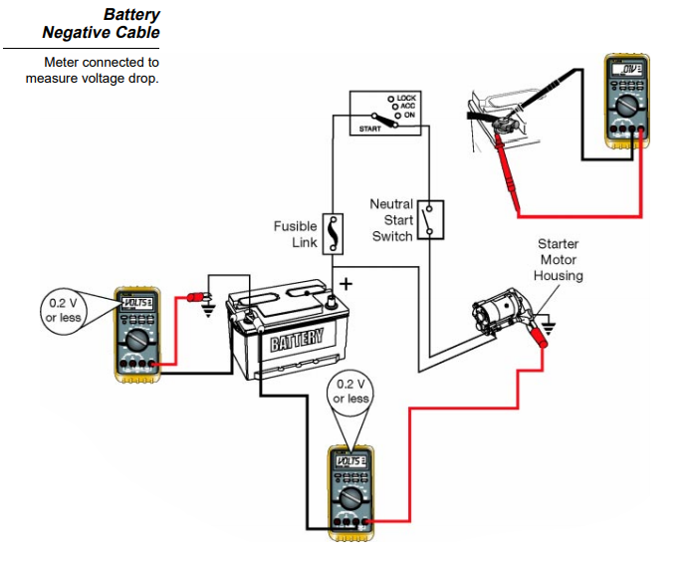
Battery Negative Cable……

Slide 16
Ignition Switch and Key
Check the ignition switch both mechanically and electrically.
Mechanically − Switch should turn smoothly without binding. Binding may mean problems with the lock cylinder or the electrical contacts.
Check the ignition key for excessive wear or rough surfaces.
Electrically − Disconnect the battery ground cable and check for continuity through the ST contacts. Refer to the appropriate service manual for wiring details.

Slide 17
Component testing and electrical testing

Slide 18
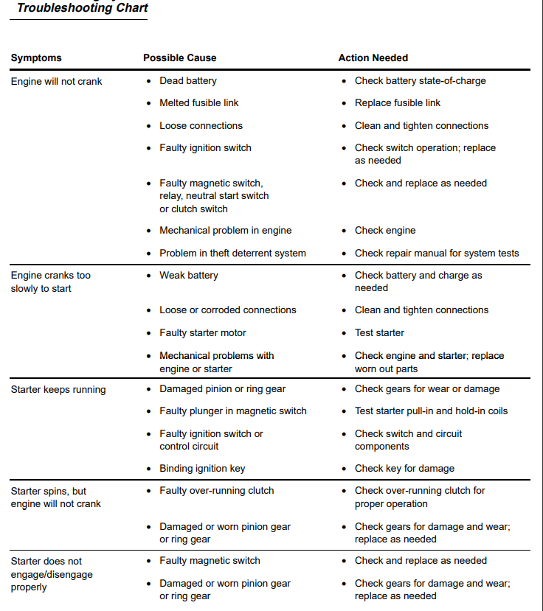

Slide 19
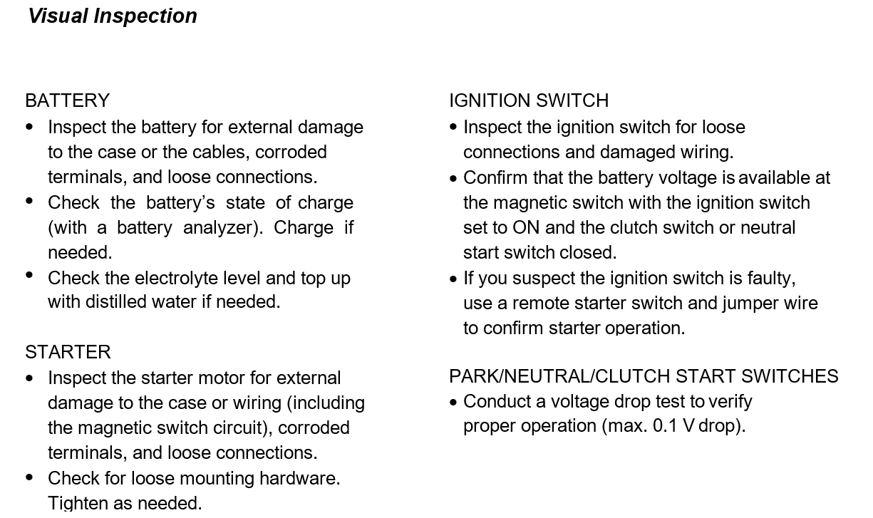

Slide 20
Reading List
Ronald K.Jurgen (2003) Sensor and Transducers, , SAE
Ronald K. Jurgen (2002) Electric and Hybrid-electric vehicles, SAE.
Tom Denton, (2000). “Automobile Electrical and Electronics Systems”, Edward Arnold Publishers,
Barry Hollembeak, (2001) “Automotive Electricity, Electronics & Computer Controls”, Delmar Publishers,.
Richard K. Dupuy (2000). “Fuel System and Emission controls”, Check Chart Publication,
Ronald. K. Jurgon, (1999) “Automotive Electronics Handbook”, McGraw-Hill,.
Ribbens, (2013) "Understanding Automotive Electronics", 7th Edition, Elsevier, Indian Reprint,
William B. Ribben, (2003). Understanding Automotive Electronics, 6th edition Elsevier Science
V. A. W. Hillier and F. W. Pittuck, (1993) Fundamentals of Motor Vehicle Technology, Hutchison Educational, London.
W. H. Crouse (1983) Automotive Mechanics, McGraw-Hill Publisher, London.
Nunney (2008), Light and Heavy Vehicle Technology, Routledge
William Ribbens (2017) Understanding Automotive Electronics, Eighth Edition, Butterworth-Heinemann;
Tom Denton (2016) Automotive Technician Training, Routledge publisher
Robert Bosch GmbH (2014) Bosch Automotive Handbook 9th Edition bently publisher
Richard Stone, Jeffrey K. Ball (2004) Automotive Engineering Fundamentals, SAE International

